Slide 1
PRINCIPLES OF
INFORMATION SECURITY
The Subject Matter, Basic Pre-requisites and Design Challenges

Slide 2
THE SUBJECT MATTER
Today’s Multi-verses of Security

Slide 3
The Four Silos of Contemporary Security
INFORMATION
THEORETIC
SECURITY
PROVABLE
SECURITY
One-Time Pad
Perfect
Secret Sharing
Unconditional Secure Multiparty Computations
etc …
Pseudo
Randomness
One-way
Functions
Zero-Knowledge
Simulations
etc …
HEURISTIC
SECURITY
UNCERTAINTY
BASED
SECURITY
Stream
Ciphers
Triple
DES
AES
etc …
Noisy Channels
Quantum
Cryptography
Asynchrony
Based
Security
etc …

Slide 4
BUT WHY DIFFERENT TYPES OF SECURITY?
P = NP : A world where it is impossible to pose questions (with easily demonstrable solutions) that are hard to answer.
P \neq NP (but only in worst-case) : A world where it is infeasible to pose questions (with easily demonstrable solutions) that are hard to answer.
Average-case hard problems, but no one-way functions : A world where it is feasible to pose questions (with easily demonstrable solutions) that are hard to answer (but infeasible for the poser himself/herself to solve it!).
One-way Functions but no PKC : A world where it is easy to pose questions (with easily demonstrable solutions) that are hard to answer.
Public-Key Cryptography : It is easy to pose questions (with easily demonstrable solutions) that are hard to answer except for a selected group.
OUR CURRENT (LACK OF) UNDERSTANDING OF THE WORLD

Slide 5
WHY IS HEAVY-DUTY MATHEMATICS NEEDED FOR SECURITY?

Slide 6
Kerckhoff’s Principle
Advantages of publishing

Slide 7
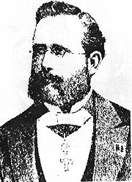
Kerckhoff’s Principle
Dr. Auguste Kerckhoff
1883
“a cryptosystem should be secure even if everything about the system, except the key, is public knowledge”

Slide 8
Useful Guidelines for Publishing
The System must be:
Practically indecipherable
Easy for anyone to know, including the enemy
The key must be easily communicable and retainable
Portable and can be used with minimal resources
Easy to use
Notes:
The system must be practically, if not mathematically, indecipherable;
It must not be required to be secret, and it must be able to fall into the hands of the enemy without inconvenience;
Its key must be communicable and retainable without the help of written notes, and changeable or modifiable at the will of the correspondents;
It must be applicable to telegraphic correspondence;
It must be portable, and its usage and function must not require the concourse of several people;
Finally, it is necessary, given the circumstances that command its application, that the system be easy to use, requiring neither mental strain nor the knowledge of a long series of rules to observe.

Slide 9
Why should it be made public?
Reverse Engineering
Costly Storage
Ease of replacement
Multiple Users
Ethical Hacking
Standards
Notes:
There is a large group of people who are capable and willing to evaluate cryptographic systems, and publishing is a way to harness the expertise of those people.
There are others who need to build cryptographic systems and are on the same side, so everyone can learn from the mistakes of others.
Undergoes public scrutiny.
Aids in stronger design.
Revelation of security flaws (by ethical hackers).
Better establishment of standards.

Slide 10
Why should it be made public? (Contd..)
There are others who need to build cryptographic systems and are on the same side, so everyone can learn from the mistakes of others.
Undergoes public scrutiny.
Aids in stronger design.
Revelation of security flaws (by ethical hackers).
Better establishment of standards.
Notes:
There is a large group of people who are capable and willing to evaluate cryptographic systems, and publishing is a way to harness the expertise of those people.
There are others who need to build cryptographic systems and are on the same side, so everyone can learn from the mistakes of others.
Undergoes public scrutiny.
Aids in stronger design.
Revelation of security flaws (by ethical hackers).
Better establishment of standards.

Slide 11
CRYPTANALYSIS OF HISTORICAL CIPHERS
Shift Cipher, Mono-alphabetic Substitution Cipher and Vigenere Cipher

Slide 12
The Shift Cipher and the Sufficient Key Space Principle

Slide 13
SHIFT CIPHER
Rotate each letter by the key k
For example, if k is 3 then:
A
D
G
J
X
A
D
G
J
X
Encryption Decryption
Enc(x) = ( x + k ) mod 26. Dec(x) = ( x - k ) mod 26

Slide 14
Example: Key = 3 and Plaintext = “ATTACK”
A
T
T
A
C
K
Enc()
D
W
W
D
F
N
Dec()
A
T
T
A
C
K

Slide 15
Problem with Shift ciphers
Not enough keys!
If we shift a letter 26 times, we get the same letter back.
A shift of 27 is the same as a shift of 1, etc.
So we only have 25 keys (1 to 25).
Therefore, easy to attack via brute force.

Slide 16
Example: Cryptanalysis of shift ciphers
Cipher text : OVDTHUFWVZZPISLRLFZHYLAOLYL
Key Value | Possible Plain Text
1 | NUCSGTEVUYYOHRKQKEYGXKZNKXK
2 | MTBRFSDUTXXNGQJPJDXFWJYMJWJ
3 | LSAQERCTSWWMFPIOICWEVIXLIVI
4 | KRZPDQBSRVVLEOHNHBVDUHWKHUH
5 | JQYOCPARQUUKDNGMGAUCTGVJGTG
6 | IPXNBOZQPTTJCMFLFZTBSFUIFSF
7 | HOWMANYPOSSIBLEKEYSARETHERE
8 | GNVLZMXONRRHAKDJDXRZQDSGDQD
9 | FMUKYLWNMQQGZJCICWQYPCRFCPC
10 | ELTJXKVMLPPFYIBHBVPXOBQEBOB
11 | DKSIWJULKOOEXHAGAUOWNAPDANA
12 | CJRHVITKJNNDWGZFZTNVMZOCZMZ
13 | BIQGUHSJIMMCVFYEYSMULYNBYLY

Slide 17
Mono-Alphabetic Substitution Cipher: Just Large Key Space Isn’t Enough!

Slide 18
Mono Alphabetic Substitution Cipher
Mapped to
Unique character in the Cipher Text
Each character in the plain text
→ A total of 26! Keys

Slide 19
Plain Text : “Tell him about me”
Assume the following mapping:
a | b | c | d | e | f | g | h | i | j | k | l | m | n | o | p | q | r | s | t | u | v
F | A | Y | E | Z | C | S | G | V | H | W | Q | B | D | J | U | I | L | K | M | X | R
w | x | y | z
T | N | O | P
The plaintext would be encrypted as follows: (ignore the spaces)
t | e | l | l |  | h | i | m |  | a | b | o | u | t |  | m | e
M | Z | Q | Q |  | G | V | B |  | F | A | J | X | M |  | B | Z

Slide 20
Frequency Analysis
Consider the cipher:
UZQSOVUOHXMOPVGPOZPEVSGZWSZOPFPESXUDBMETSXAIZVUEPHZHMDZSHZOWSFPAPPDTSVPQUZWYMXUZUHSXEPYEPOPDZSZUFPOMBZWPFUPZHMDJUDTMOHMQ
Standard Frequency Distribution of English Alphabets:

Slide 21
Frequency of alphabets in the cipher text:
P 13.33 | H 5.83 | F 3.33 | B 1.67 | C 0.00
Z 11.67 | D 5.00 | W 3.33 | G 1.67 | K 0.00
S 8.33 | E 5.00 | Q 2.50 | Y 1.67 | L 0.00
U 8.33 | V 4.17 | T 2.50 | I 0.83 | N 0.00
O 7.50 | X 4.17 | A 1.67 | J 0.83 | R 0.00
M 6.67
What is the actual mapping?
{P,Z} Є {e,t}
{S,U,O,M,H} Є {a,h,I,n,o,r,s}
{A,B,G,Y,I,J} Є {b,j,k,q,v,x,z}

Slide 22
it was disclosed yesterday that several informal but direct contacts have been made with political representatives of the viet cong in moscow
The Plaintext (after breaking it)

Slide 23
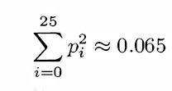
A Statistical Approach to Break Shift Cipher
p_{i} : Probability of i^{th} character in plaintext
q_{i} : Probability of i^{th} character in ciphertext
Find k such that I_{k} is nearly 0.065

Slide 24
Vigenere Cipher: Code Complexity Does Not Guarantee Security!

Slide 25
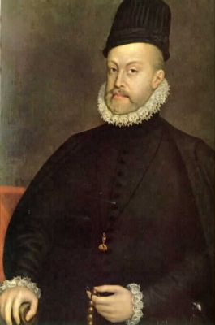
Vigenere Cipher
Poly alphabetic substitution
Each character in the plain text
Mapped to
Any character in the Cipher Text
Try breaking my cipher !
Blaise de Vigenere

Slide 26
Encryption
Periodic key: deceptivedeceptivedeceptive
Plaintext: wearediscoveredsaveyourself
Ciphertext: ZICVTWQNGRZGVTWAVZHCQYGLMGJ
d | e | c | e | p | t | i | v | e | d | e | c | e | p | t | i | v | e | d | e | c | e | p | t | i | v | e
w | e | a | r | e | d | i | s | c | o | v | e | r | e | d | s | a | v | e | y | o | u | r | s | e | l | f
Z | I | C | V | T | W | Q | N | G | R | Z | G | V | T | W | A | V | Z | H | C | Q | Y | G | L | M | G | J

Slide 27


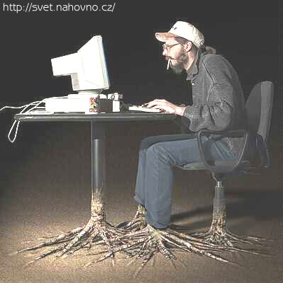

Cryptanalysis of Vigenere Cipher
Brute force
Infeasible !
Frequency Analysis
Information is Obscured !
Unbreakable ?
NO !
Still there is scope for Frequency Analysis !
Not all information is lost !
Attacker

Slide 28
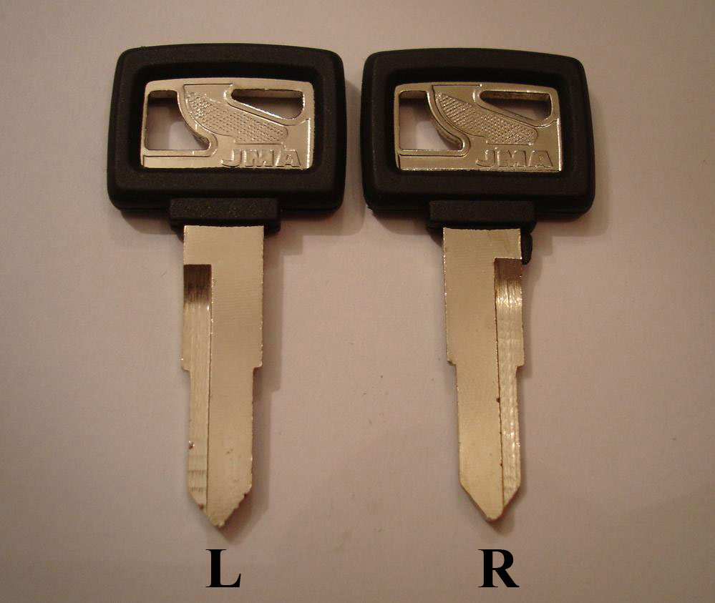

Cryptanalysis (Contd.)
1. Find the Key Length
Two Steps:
2. Find the Key

Slide 29

A Statistical Approach to Vigenere Cipher
p_{i} : Probability of i^{th} character in plaintext
q_{i} : Probability of i^{th} character in the cipher sub-sequence
Find key length t such that S_{t} is nearly 0.065
Once key length t is found, Vigenere cipher is nothing but a collection of t shift ciphers!

Slide 30
DESIGNING SECURE SYSTEMS
IS HARD
The entry of SHANNON’s Genius (next class!)

Slide 31
THANK YOU
Any Questions?

